Slide 1
Optimizers

Slide 3
Outline
Challenges in Optimization
Momentum
Adaptive Learning Rate

Slide 4
Outline
Challenges in Optimization
Momentum
Adaptive Learning Rate

Slide 5
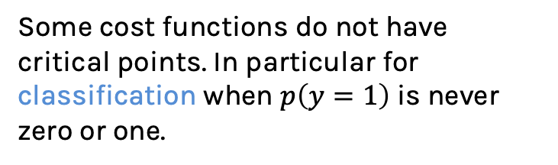
Challenges in Optimization
Local Minima
No critical points
Ideally, we would like to arrive at the global minimum, but this might not be possible. Some local minima performs as well as the global one, so it is an acceptable stopping point.
Some cost functions do not have critical points. In particular for classification when $p\left(y=1\right)$ is never zero or one.

Slide 6
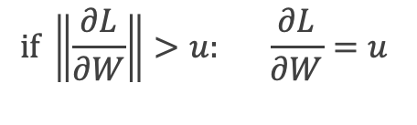
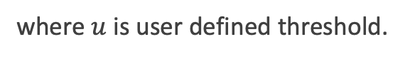
Challenges in Optimization
Exploding and vanishing Gradients
Poor Conditioning
Exploding gradients due to cliffs. Can be mitigated using gradient clipping:
Poorly conditioned Hessian matrix. High curvature: small steps leads to huge increase. Learning is slow despite strong gradients. Oscillations slow down progress.
$$if \left\|\frac{∂L}{∂W}\right\|>u: \frac{∂L}{∂W}=u$$
where $u$ is user defined threshold.

Slide 7
Outline
Challenges in Optimization
Momentum
Adaptive Learning Rate

Slide 8
Momentum
Oscillations because updates do not exploit curvature information
Average gradient presents faster path to optimal: vertical components cancel out
$$L(W)$$
$$W_{2}$$
$$W_{1}$$
Notes:
https://distill.pub/2017/momentum/

Slide 9
Momentum
Question: Why not this?
$$L(W)$$
$$W_{2}$$
$$W_{1}$$
Notes:
https://distill.pub/2017/momentum/

Slide 10
Momentum
Let us figure out an algorithm which will lead us to the minimum faster.
$$L(W)$$
$$W_{2}$$
$$W_{1}$$
Notes:
https://distill.pub/2017/momentum/

Slide 11
Momentum
Look each component at a time
$$L(W)$$
$$W_{2}$$
$$W_{1}$$
Notes:
https://distill.pub/2017/momentum/

Slide 12
Momentum
Let us figure out an algorithm
$$L(W)$$
$$W_{2}$$
$$W_{1}$$
Notes:
https://distill.pub/2017/momentum/

Slide 13
Momentum
Let us figure out an algorithm
$$L(W)$$
$$W_{2}$$
$$W_{1}$$
Notes:
https://distill.pub/2017/momentum/

Slide 14
Momentum
Let us figure out an algorithm
$$L(W)$$
$$W_{2}$$
$$W_{1}$$
Notes:
https://distill.pub/2017/momentum/

Slide 15
Momentum
Add the average of the gradient from before
$$L(W)$$
Current gradient
$$W_{2}$$
Average gradient up to this moment
$$W_{1}$$
Notes:
https://distill.pub/2017/momentum/

Slide 16
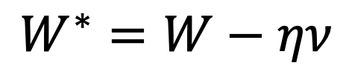
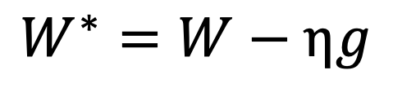
Momentum
$f$is the Neural Network
Old gradient descent:
New gradient descent with momentum:
$$g= \frac{1}{m}\sum_{i}{∇_{W}L(f\left(x_{i};W\right),y_{i})}$$
$$W^{∗}=W−ηg$$
$$ν=αν+(1−α) g$$
$$W^{∗}=W−ην$$
controls how quickly effect of past gradients decay

Slide 17
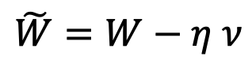
Nesterov Momentum
Apply an interim update:
Perform a correction based on gradient at the interim point:
$$\tilde{W}=W−η ν$$
$$g= \frac{1}{m}\sum_{i}{∇_{W}L(f\left(x_{i};\tilde{W}\right), y_{i})}$$
Momentum based on look-ahead slope

Slide 18
Outline
Challenges in Optimization
Momentum
Adaptive Learning Rate

Slide 19
Adaptive Learning Rates
$$L(W)$$
$$W_{2}$$
Slow
Fast
$$W_{1}$$
Oscillations along vertical direction
Learning must be slower along parameter 2
Use a different learning rate for each parameter?

Slide 20
Adaptive Learning Rates
$$L(W)$$
$$W_{2}$$
Slow
Fast
$$W_{1}$$
Oscillations along vertical direction
Learning must be slower along parameter 2
Use a different learning rate for each parameter?

Slide 21
Adaptive Learning Rates
$$L(W)$$
$$W_{2}$$
Slow
Fast
$$W_{1}$$
Oscillations along vertical direction
Learning must be slower along parameter 2
Use a different learning rate for each parameter?

Slide 22
Adaptive Learning Rates
$$L(W)$$
$$W_{2}$$
Slow
Fast
$$W_{1}$$
Oscillations along vertical direction
Learning must be slower along parameter 2
Use a different learning rate for each parameter?

Slide 23
Adaptive Learning Rates
$$L(W)$$
$$W_{2}$$
Slow
Fast
$$W_{1}$$
Oscillations along vertical direction
Learning must be slower along parameter 2
Use a different learning rate for each parameter?

Slide 24
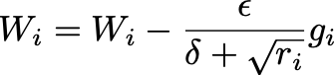
AdaGrad
Accumulate squared gradients:
Update each parameter:
Greater progress along gently sloped directions
$g$is the gradient
Inversely proportional to cumulative gradient

Slide 25
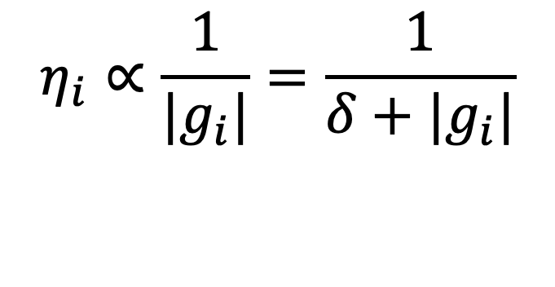
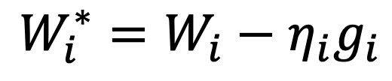
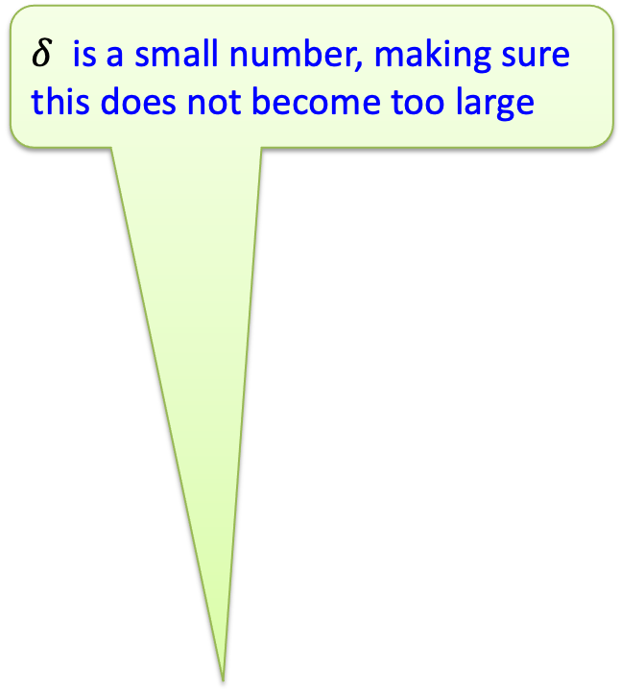
AdaGrad
$δ$ is a small number, making sure this does not become too large
Old gradient descent:
$$g= \frac{1}{m}\sum_{i}{∇_{W}L(f\left(x_{i};W\right),y_{i})}$$
$$W^{∗}=W−λg$$
We would like $λ^{′}s$ not to be the same and inversely proportional to the${|g}_{i}|$
$$W_{i}^{∗}=W_{i}−η_{i}g_{i}$$
$$η_{i}∝\frac{1}{{|g}_{i}|}=\frac{1}{δ+|g_{i}|}$$
New gradient descent with adaptive learning rate:
$$W_{i}^{∗}=W_{i}−\frac{ε}{δ+\sqrt{r_{i}}}g_{i}$$
$$r_{i}^{∗}=r_{i}+g_{i}^{2}$$

Slide 26
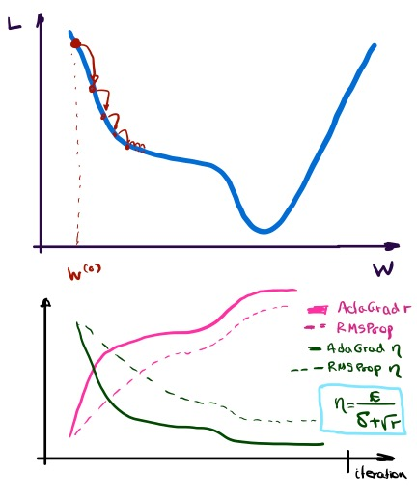
RMSProp
For non-convex problems, AdaGrad can prematurely decrease learning rate
Use exponentially weighted average for gradient accumulation

Slide 27
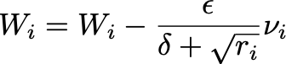
Adam
RMSProp + Momentum
Estimate first moment:
Estimate second moment:
Update parameters:
Also applies bias correction to v and r
Works well in practice, it is fairly robust to hyper-parameters

Slide 28
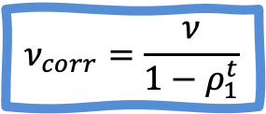
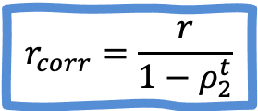
Bias Correction
To perform bias correction on the two running average variables, we use the following equations. We do this before we update weights.
$$ν_{corr}=\frac{ν}{1−ρ_{1}^{t}}$$
$$r_{corr}=\frac{r}{1−ρ_{2}^{t}}$$
Where $t$ is the number of the current iteration.

